Slide 1

Application of SiC as cladding material (non- TRISO application)
NE 795 Class Presentation
Khadija Mahbuba
Graduate Student
Department of Nuclear Engineering
North Carolina State University

Slide 2
Outline
Background
Production of SiC based cladding
Behaviors of SiC based cladding
Summary

Slide 3
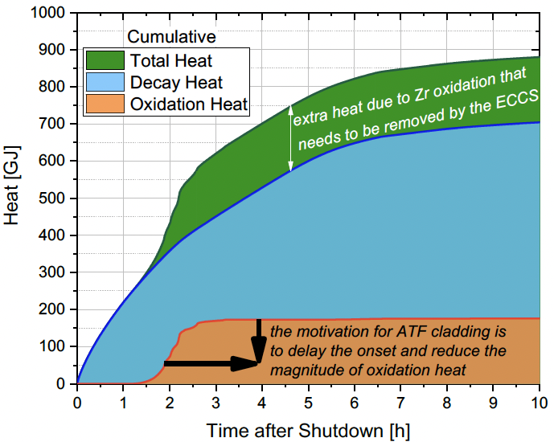
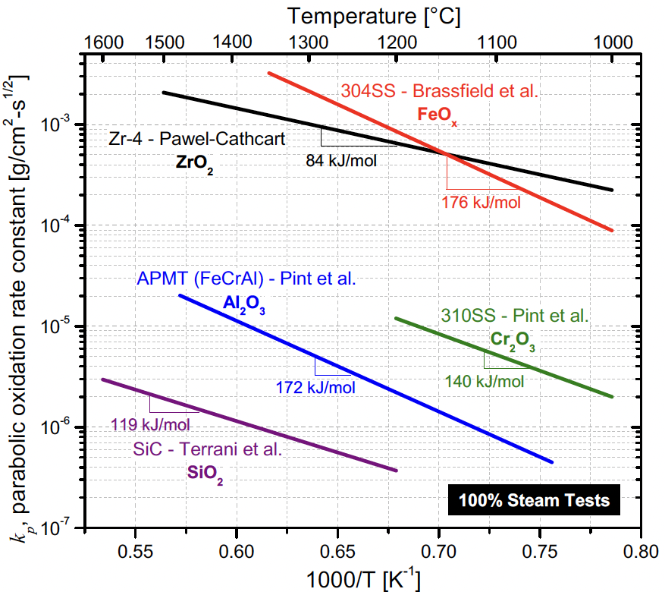
Background
Why do we need new cladding material?
The idea of replacing the metal cladding (Zr based alloy) in LWR with a ceramic composite began to emerge after a decade of studying the core that melted in the accident at Three Mile Island Unit 2 (TMI-2) in 1979
Earliest ceramic composite: alumina fibers and an alumina matrix, known as a continuous fiber ceramic composite (CFCC)=>pros: lower thermal expansion, lower heat generation in cladding reaction; cons: permeable to fission gas and loose strength under irradiation
Multilayered SiC/SiC composite based cladding named as Triplex ceramic cladding for commercial use in 2009
After Fukushima accident in 2011, concept of ATF(accident accident tolerant fuel) starts to get more focus
Vendors have also expressed interest in increasing fuel burnup above licensed limits roughly about 62 GWd/MTU rod-average)

Slide 4
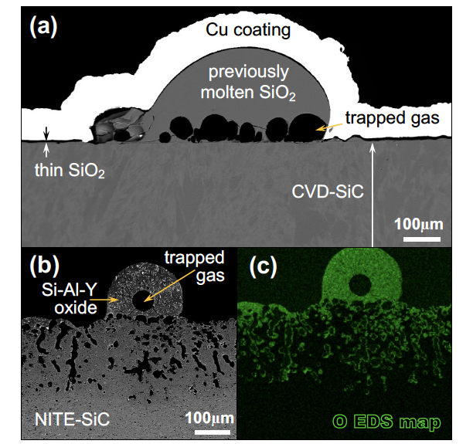
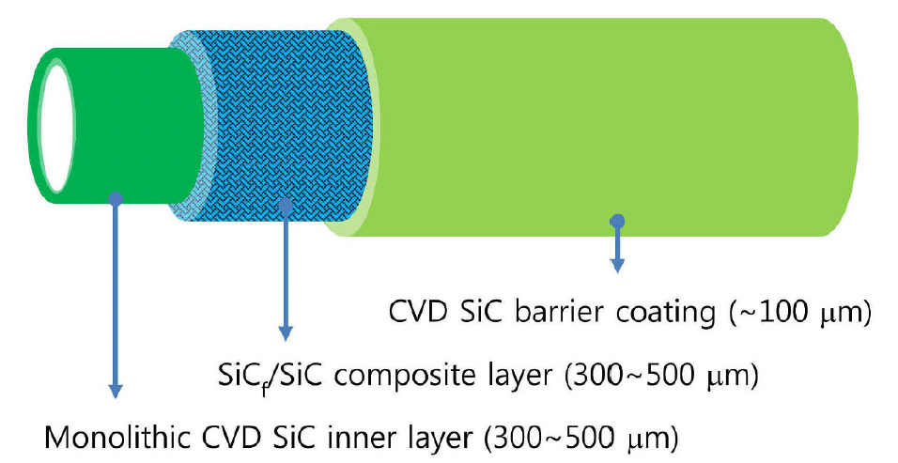
Production method of SiC based cladding
Method 1
The inner monolith provides strength and hermeticity for the tube, , the composite layer (CVI=chemical vapor infiltered) adds strength to the monolith while providing a pseudo-ductile failure mode in the hoop direction, and the outer SiC coating protects against corrosion (EBC)
Method 2
Nano-infiltration and transient eutectic phase (NITE) process with utilization of hot pressing => more dense material thus improving material property and better hermiticity to fission gas
A combination of method 1 and 2 is also utilized
After oxidation in 1700C steam for (a) 2 hrs and (b,c) 0.5 hrs

Slide 5
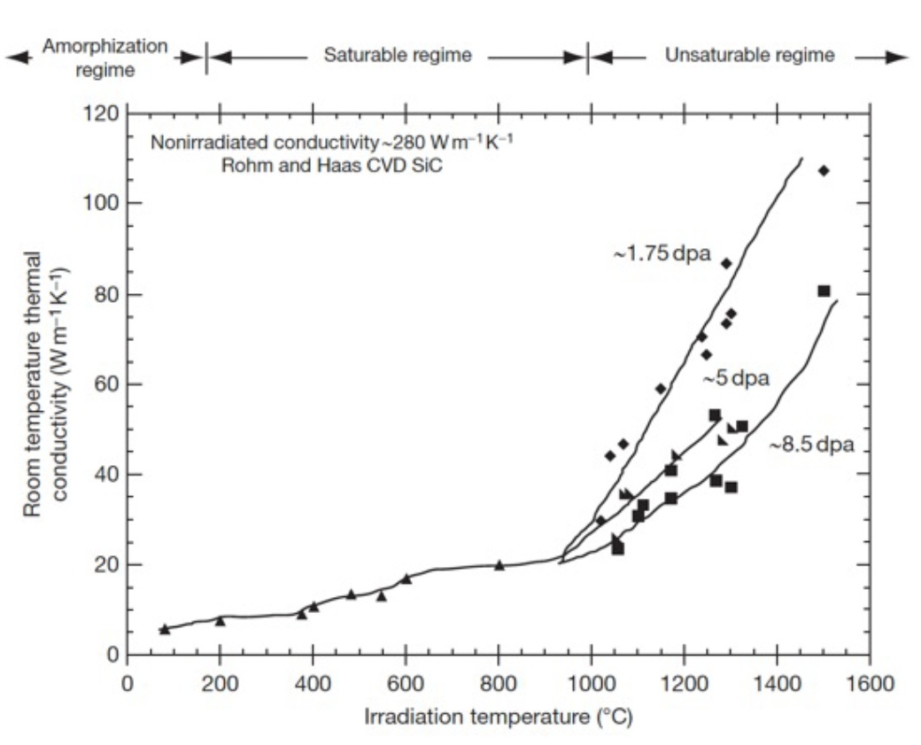
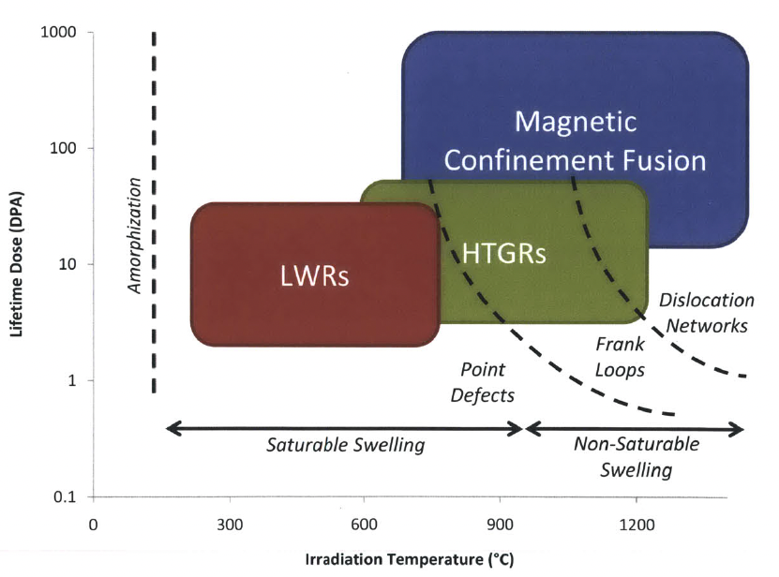
Behaviors of SiC cladding in LWR

Slide 6
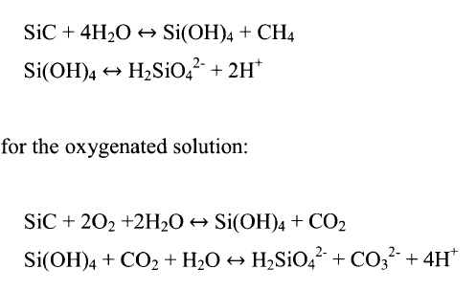
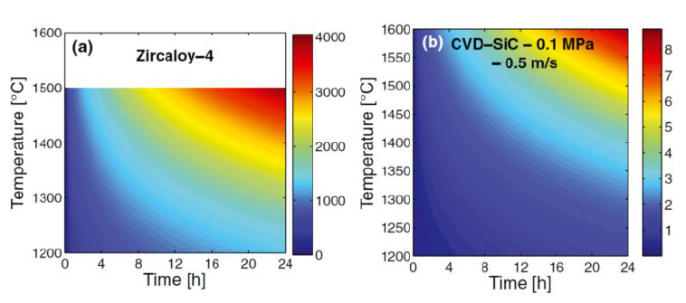
Behaviors of SiC based cladding in LWR (cont)
1. Aqueous corrosion
Corrosion process is initiated with oxidation of Si. SiO₂ layer undergoes slow volatilization
Formation of Si(OH)₄ and dissolution as silisic acid => weight loss of SiC cladding
Si(OH)₄ dissolved more easily in alkaline water
Presence of impurities decreases aqueous corrosion resistance
CVD SiC has more resistance; corrosion highly depends on microstucture
Si depletion occurs at exposed surfaces and grain boundaries ; High angle GBs are more prone to corrosion
Increment of O₂ make coolant more corrosive.
At 300 C. 10 MPa, O₂ < 10 ppb, 225 days, unirradiated => Zero corrosion. In –pile hydrothermal corrosion (~1 dpa) shows about 6% -10% weight loss.
SiC plate joint bonds (TiC/SiC tape, calcium aluminate glass, or titanium foil) are completely or partially debonded after exposure to 0.16 dpa for 44 days)
For deaerated solution:
Thickness consumed (micron)

Slide 7
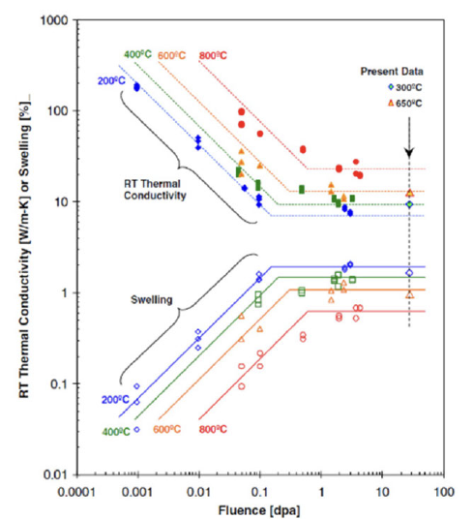
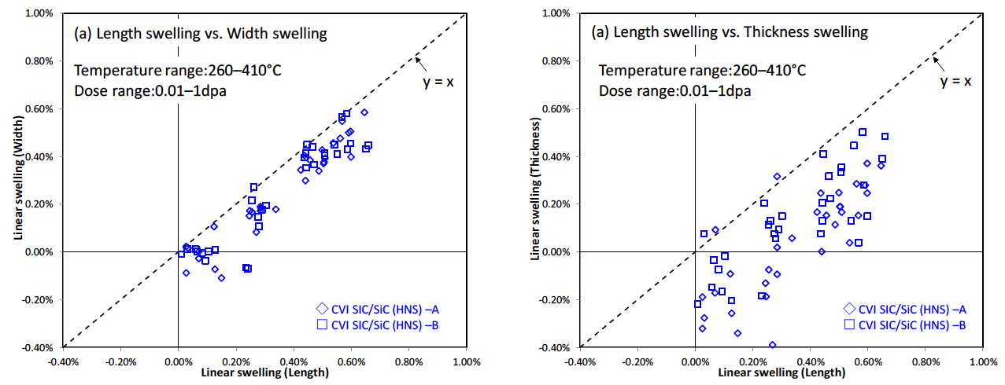
Behaviors of SiC cladding in LWR (cont)
2. Thermal property
Though pure SiC has a higher thermal conductivity, the SiC composite layer has lower (25-30 W/m-K) which is reduced to (3-5 W/m-K) after irradiation in LWR condition
Results in 100 C temperature gradient in radial direction
Average fuel temperature is 280 C higher than Zr based cladding, lead to annular fuel design
Anisotropic swelling in SiC composite layer

Slide 8
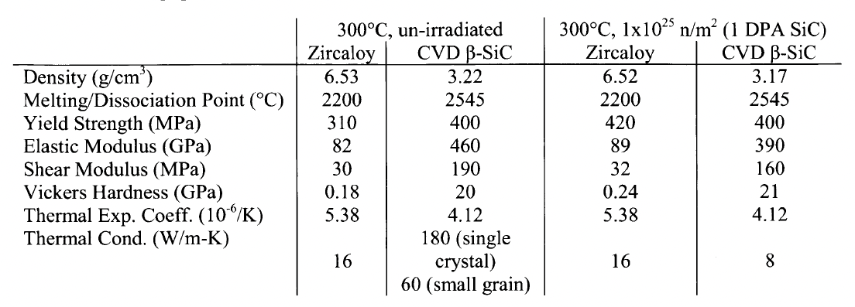
Behaviors of SiC cladding in LWR (cont)
3. Mechanical property
Almost time independent during a high temperature transient.
The high elastic modulus and lack of cladding creep at LWR temperatures mean that PCMI can be completely avoided even in the peak power rods
Water quench tests from 1000 C up to 1500C result in only a small decrease in mechanical properties, while hoop stress tests irradiated at PWR coolant and neutronic conditions revealed a 10% to 60% reduction in strength due to mismatched physical properties among the three layers, and corrosion
Though Zr based alloy has higher ultimate tensile strength, shear strength of non- SiC bonding layer is reduced by ~30% under irradiation and shows irradiation induced microcracking which don not happen in SiC based bonding layers
Will maintain a coolable geometry (not fragmented) at high temperature, which is a very important improvement in accident conditions

Slide 9
Behaviors of SiC cladding in LWR (cont)
4. Neutronic property
Neutron absorption cross-section is lower than Zr based cladding
Enables a smaller uranium enrichment and that could also result in increasing the fuel cycle duration
Inherent low activation
Lack of progressive irradiation growth compared to Zr based cladding
5. Fission product behaviour
A fully ceramic SiC-cladding design cannot prevent the micro-cracking of the matrix beyond the elastic limit to the composite, while a metal/ceramic multi-layer SiC/SiC composite cladding, due to the fair ductility of the metal, withstands the strain imposed by the deformation of the composite to improve the leak-tightness.
Microcracking is characterized by formation of a pathway, likely a network of microcracks, that allows for release of radionuclides from the cladding internals to the coolant.
6. Compatibility with fuel
No notable interaction between SiC and UO₂below 1200 C

Slide 10
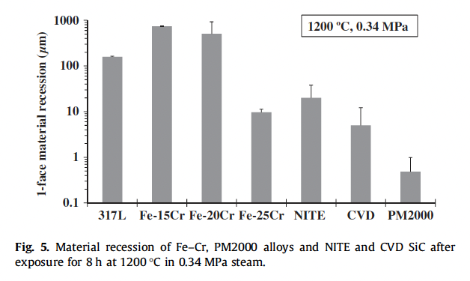
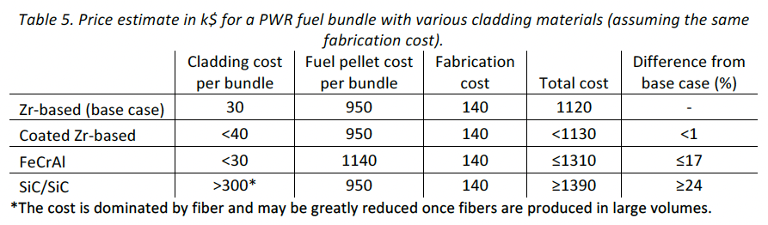
Summary
SiC based claddings are highly heterogenous
SiC based claddings show excellent HT strength and an outstanding oxidation resistance to an HT steam , thus increase the fuel margin during LOCAs
The hydrothermal corrosion of SiC and the FPs retention capability of SiC and SiC composites are identified as critical feasibility issues that need to be fully addressed
Hydrogen water chemistry could be a solution
Cheaper manufacturing process is required for SiC based cladding
Not in the presentation
1

Slide 11
Thank you!
Questions??

